Slide 1
BAYESIAN CLASSIFICATION
Prior Probability
The probability P(H) is called the prior probability of H, i.e the probability that any given data sample is an apple, regardless of how the data sample looks
The probability P(H|X) is called posterior probability. It is based on more information, then the prior probability P(H) which is independent of X

Slide 2
BAYESIAN CLASSIFICATION
Posterior Probability
Example:
Let the data samples be fruits described by their colour and shape
Suppose X = red and round
and H = hypothesis that X is an apple
Then P(H|X) is the probability that X is an apple given that X is red and round

Slide 3
BAYESIAN CLASSIFICATION
Bayes Theorem
It provides a way of calculating the posterior probability
P(H|X) = P(X|H) P(H)
P(X)
P(X|H) is the posterior probability of X given H (it is the probability that X is red and round given that X is an apple)
P(X) is the prior probability of X (probability that a data sample is red and round)

Slide 4
BAYESIAN CLASSIFICATION
Bayes Theorem: Proof
The posterior probability of the fruit being an apple given that its shape is round and its colour is red is P(H|X) = |H ∧ X| / |X|
i.e. the number of apples which are red and round divided by the total number of red and round fruits
Since P(H ∧ X) = |H ∧ X| / |total fruits of all size and shapes|
and P(X) = |X| / |total fruits of all size and shapes|
Hence P(H|X) = P(H ∧ X) / P(X)

Slide 5
BAYESIAN CLASSIFICATION
Bayes Theorem: Proof
Similarly P(X|H) = P(H ∧ X) / P(H)
Hence we have P(H ∧ X) = P(H|X)P(X)
And also P(H ∧ X) = P(X|H)P(H)
Therefore P(H|X)P(X) = P(X|H)P(H)
And hence P(H|X) = P(X|H) P(H) / P(X)

Slide 6
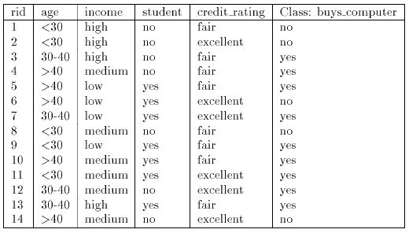
BAYESIAN CLASSIFICATION
Naïve (Simple) Bayesian Classification
Example:

Slide 7
BAYESIAN CLASSIFICATION
Naïve (Simple) Bayesian Classification
Example:
Let C₁ = class buy computer and C₂ = class not buy computer
The unknown sample:
X = {age ≤ 30, income = medium, student = yes, credit-rating = fair}
The prior probability of each class can be computed as
P(buy computer = yes) = 9/14 = 0.643
P(buy_computer = no) = 5/14 = 0.357

Slide 8
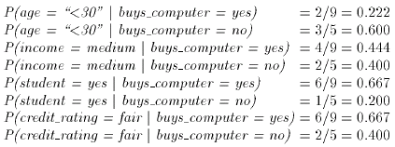
BAYESIAN CLASSIFICATION
Naïve (Simple) Bayesian Classification
Example:
To compute P(X|Ci) we compute the following conditional probabilities

Slide 9
BAYESIAN CLASSIFICATION
Naïve (Simple) Bayesian Classification
Example:
Using the above probabilities we obtain
And hence the naïve Bayesian classifier predicts that the student will buy computer, because

